Slide 1
Pipelining, Caching, Superscalar and more!!!
CS 0447
Jarrett Billingsley

Slide 2
Class announcements
let’s get through this real quick so we can do the review
the stuff today might only be a few vocab words on the exam but it’s INTERESTING and GOOD TO KNOW so I’m telling you about it

Slide 3
Pipelining

Slide 4
The idea
when you do several loads of laundry…
…do you wash, dry, and fold one load BEFORE doing the next?
or do you start on the next one while the previous one is drying?

Slide 5
chugga chugga choo choo (animated)
what if… we just kept fetching instructions on each clock cycle?
F
D
X
M
sub
sw
add
Control
Register File
Memory
Memory again?
W

Slide 6
But… why (animated)
did we make any individual instruction faster?
no, the add and sub still took 4 cycles…
but they finished faster. how? well let’s consider a simpler datapath with only two stages: fetch and execute.
6 cycles for 3 instructions
(CPI = 2)
non-pipelined:
F
X
F
X
F
X
pipelined:
F
X
4 cycles for 3 instructions (CPI = 1.3) because on any given cycle, we are doing more work. that is, we improved the throughput!
F
X
F
X
the longer the sequence of instructions gets, the closer the CPI gets to 1.
and the more stages instructions have, the higher the throughput gets.
Notes:
- even some of the early 8-bit microprocessors, like the 6502, were doing a limited kind of pipelining on their multi-cycle instructions. the 6502 could start fetching and decoding the next instruction on the last cycle of some instructions. at the time, it offered some of the best performance you could get from an 8-bit CPU.

Slide 7
CPI is an average
for any program, we can count cycles and instructions, then divide.
Time | 1 | 2 | 3 | 4 | 5 | 6 | 7 | 8
add t0, t1, t2
add t3, t4, t5
add s0, s1, s2
add s3, s4, s5
F
D
W
CPI = 7 ÷ 4
= 1.75
X
F
D
W
X
F
D
W
X
F
D
W
X

Slide 8
Structural hazards
two instructions need to use the same hardware at the same time
Time | 1 | 2 | 3 | 4 | 5 | 6 | 7 | 8
lw t0, 0(sp)
lw t1, 4(sp)
lw t2, 8(sp)
lw t3,12(sp)
F
D
M
X
well, now they need to take turns… but that sucks
F
D
X
F
D
maybe Harvard architectures were onto something after all
F
Notes:
- wait, we'll come back to this one when we talk about caching.

Slide 9
Data hazards
an instruction depends on the result of a previous one
Time | 1 | 2 | 3 | 4 | 5 | 6 | 7 | 8
add t0, t1, t2
sub s0, t0, t1
F
D
W
X
F
D
W
X
sub can't use the value of t0 until the beginning of cycle 5
because that's when the add writes its result
or… we could be clever and forward the result of add to sub before the add even completes
Notes:
- we know the result of the add at the beginning of cycle 4; it just hasn't been written to the registers yet
- this presents a bit of an issue if you have to pause the CPU, say, for debugging
- in that case you have to "flush" the in-progress instructions in order to see a consistent set of values in the registers

Slide 10
Control hazards
you don't know the outcome of a conditional branch
Time | 1 | 2 | 3 | 4 | 5 | 6 | 7 | 8
beq t0,0, _end
add t0, t1, t2
lw t4, (t0)
F
D
uh oh
X
F
D
F
what if, at cycle 4, we realize we should have taken the branch?
what do we do with the 2 in-progress instructions?
should we have fetched them at all?
Notes:
- there is a bottomless pit of solutions here. stalling, branch delay slots, branch prediction, speculative execution, etc.

Slide 11
Caching or, maybe Harvard architectures are useful

Slide 12
Well this is a pickle
EVERY cycle, we need to fetch, so this situation is unacceptable.
Time | 1 | 2 | 3 | 4 | 5 | 6 | 7 | 8
lw t0, 0(zero)
lw t1, 4(zero)
lw t2, 8(zero)
lw t3,12(zero)
F
D
M
W
X
F
D
M
W
X
F
D
M
W
X
F
D
M
W
X

Slide 13
Also, memory is slow
registers are fast, but tiny.
?
what about something in-between, in size and speed?
memory is huge, but about 100-200 times slower than registers.

Slide 14
It's pronounced "cash"
a cache is a temporary holding area for recently-used data.
memory accesses really reference the cache, which is a copy of the data from memory, filled in as needed.
when we load this variable the first time, a copy of it gets pulled into the cache, then into the register.
5
6
6
we modify the value in the register.
5
6
when we store, it only stores into the cache…
so if we access it again soon, it'll still be in the cache, and it'll load much quicker.
5
Notes:
- this opens up a HUGE can of worms: now the cache's copy of the value is different from the one in memory.
- dealing with this is an enormously complex topic.

Slide 15
How does this help?
caching exploits temporal and spatial locality.
temporal: these variables are used over and over, very quickly. it makes sense to keep them somewhere fast to access!
int sum = 0;
for(int i = 0; i < len; i++)
sum += A[i];
spatial: the items in this array are all next to each other in memory. the cache will "pull in" several items at a time.
Notes:
- also, the local variables are all next to each other on the stack, so all the locals will be pulled into the cache.
- some CPUs will even detect that you are doing sequential accesses in an array, and "prefetch" the next several array items.

Slide 16
Von Neumann on the outside, Harvard on the inside
what's weird is that we usually have two caches, and therefore two memories… but only within the CPU.
CPU
I-Cache
Ctrl
Regs
D-Cache
ONE memory!
Notes:
- this actually works well for more than one reason
- not only does this resolve the structural hazard between fetches and loads/stores…
- but instruction accesses and data accesses tend to have very different patterns
- code is almost always read-only, and accessed mostly sequentially
- data is mostly read-write, and has much more complex access patterns
- we can specialize the hardware for each kind of cache to get the best performance
- and finally, giving each their own cache avoids them fighting for the limited cache space

Slide 17
Superscalar CPUs

Slide 18
The holy grail
the absolute best we can do is finish 1 instruction each cycle
CPI=1
…
or is it

Slide 19
Breaking the sound CPI=1 barrier
a scalar CPU can finish at most 1 instruction per cycle
a superscalar CPU finishes more than 1 instruction per cycle
fetch multiple instructions at once
ALU Path
an add would go here
Control
Register File
ALU
I-cache
ALU
D-cache
Memory Path
a load would go here

Slide 20
Example code
this superscalar CPU fetches two instructions at once
it might only be able to execute one, but two in the best case
lw t0, 0(s1)
lw t1, -4(s1)
sub s1, s1, 8
add t0, t0, s2
add t1, t1, s2
sw t0, 8(s1)
sw t1, 4(s1)
Cycle | ALU Path | Mem Path
1 |  | lw t0
2 | sub s1 | lw t1
3 | add t0
4 | add t1 | sw t0
5 |  | sw t1
CPI = 5 ÷ 7
= 0.71??
IPC = 7 ÷ 5 = 1.4!
since IPC is the reciprocal of CPI, bigger is better.
Notes:
- IPC = Instructions Per Cycle, and is a common unit to see performance measured in.

Slide 21
Out-of-order CPUs

Slide 22
We have to go deeper
instruction streams are inherently linear
but the computations they describe might not be
lw t0, 0(s1)
lw t1, -4(s1)
sub s1, s1, 8
add t0, t0, s2
add t1, t1, s2
sw t0, 8(s1)
sw t1, 4(s1)
these data dependencies form sequences that "weave" through the code
we could exploit this fact to reorder the instructions to run in a more convenient order… at runtime.

Slide 23
Bringing order to the chaos (animated)
what if we ran them more like this?
lw t0,0(s1)
Cyc
1
2
3
4
lw t1,-4(s1)
sub s1,s1,8
wait for loads…
add t0,t0,s2
add t1,t1,s2
sw t0,8(s1)
sw t1,4(s1)
IPC = 7 ÷ 4 = 1.75!

Slide 24
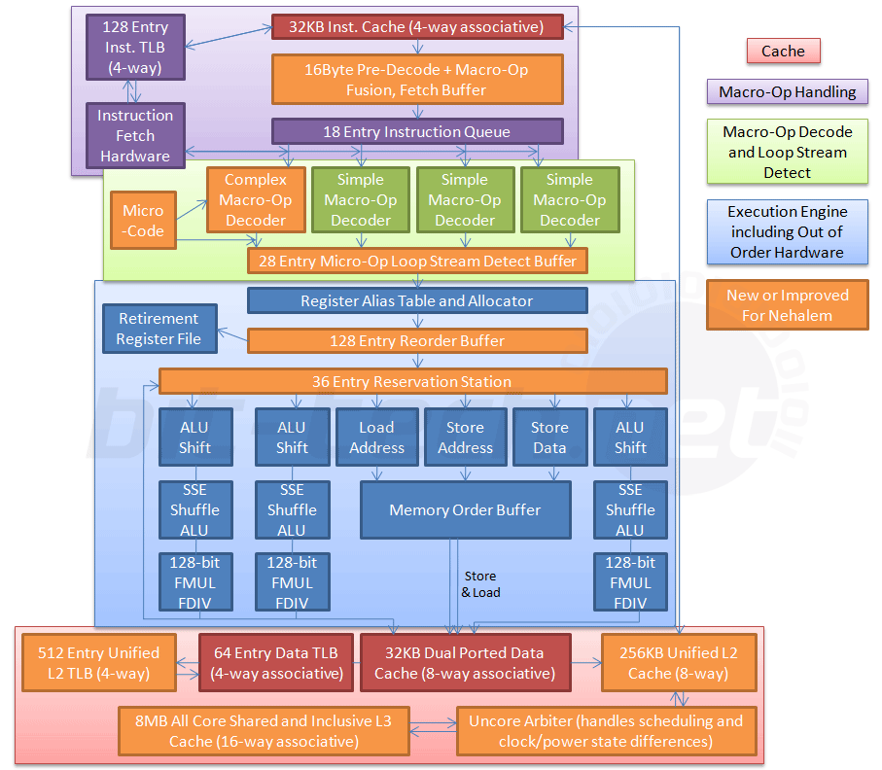
geez.
This is a diagram of the
Intel Core i7 Nehalem architecture from 2008.

Slide 25
screaming
isn't it crazy???
there's caching and virtual memory and the TLB…
…and register renaming and hazard detection and data forwarding…
…and branch prediction and loop detection…
…and simultaneous multithreading and vector processing…
…and there's so much more.
take CS1541 if this stuff interests you.

Slide 26
and… that's the end.

